Slide 1
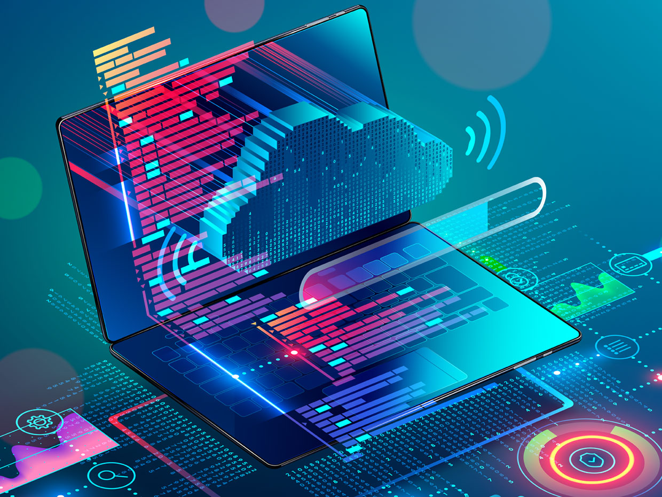

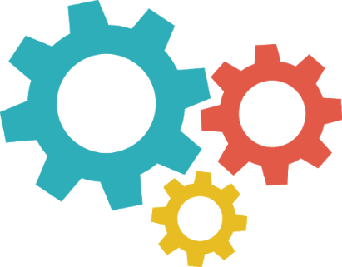
Software Development Life Cycle (SDLC)

Slide 2
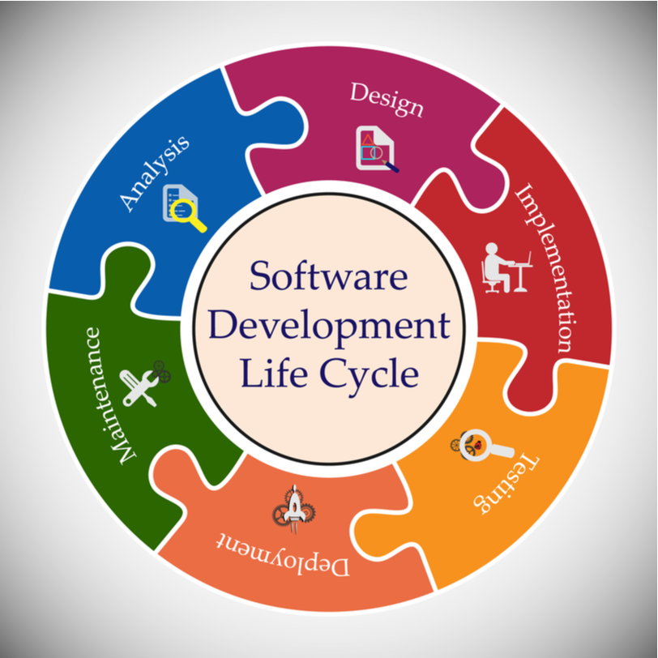
SDLC Definition
The software development life cycle (SDLC) is a framework defining tasks performed at each step in the software development process
SDLC is a structure followed by a development team within the software organization
It consists of a detailed plan describing how to develop, maintain and replace specific software.
The life cycle defines a methodology for improving the quality of software and the overall development process.
The software development life cycle is also known as the software development process
?
MVP Phase

Slide 3
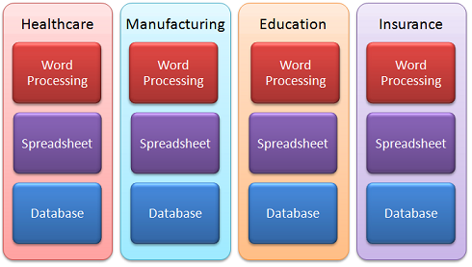
Industry Segmentation
Vertical Market
?
A vertical market is a market encompassing a group of companies and customers that are all interconnected around a specific niche
?
MVP Phase
MVP Phase
Horizontal Market
A horizontal market is one in which all of your customers use your product to do the same thing, regardless of what industry they are in.
Phase II & III
and
Support
Phase
Notes:
VMware ESXi (formerly ESX) is an enterprise-class, type-1 hypervisor developed by VMware for deploying and serving virtual computers

Slide 4
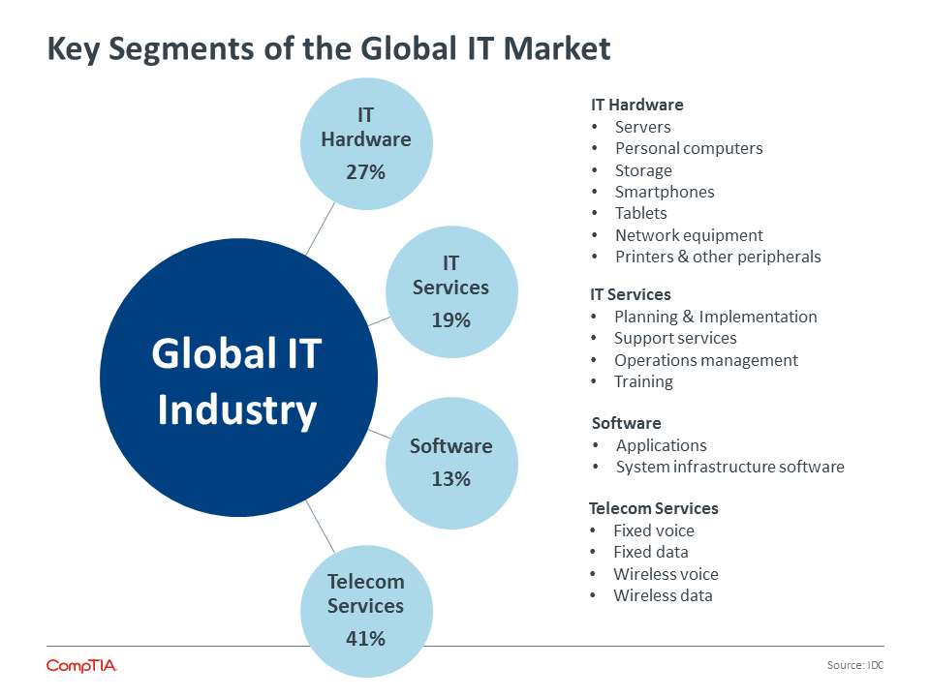
IT Segmentation
?
MVP Phase
MVP Phase
Phase II & III
and
Support
Phase
Notes:
VMware ESXi (formerly ESX) is an enterprise-class, type-1 hypervisor developed by VMware for deploying and serving virtual computers

Slide 5
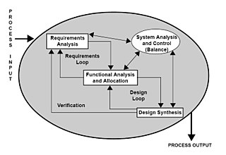
Requirements
Stakeholder identification
Elicitation
Elicitation is the gathering and discovery of requirements from stakeholders and other sources
Joint Requirements Development (JRD) Sessions
Interviews
Document Analysis
Analysis
Analysis is the logical breakdown that proceeds from elicitation. Analysis involves reaching a richer and more precise understanding of each requirement and representing sets of requirements in multiple, complementary ways.
Specification
Document collected requirements knowledge in a persistent and well-organized fashion that facilitates effective communication and change management.
Use cases, user stories, functional requirements, and visual analysis models
Validation
Management
?
MVP Phase

Slide 6
Requirements
Stakeholder identification
Elicitation
Elicitation is the gathering and discovery of requirements from stakeholders and other sources
Joint Requirements Development (JRD) Sessions
Interviews
Document Analysis
Analysis
Analysis is the logical breakdown that proceeds from elicitation. Analysis involves reaching a richer and more precise understanding of each requirement and representing sets of requirements in multiple, complementary ways.
Specification
Document collected requirements knowledge in a persistent and well-organized fashion that facilitates effective communication and change management.
Use cases, user stories, functional requirements, and visual analysis models
Validation
Management
?
MVP Phase

Slide 7
Requirements
Functional requirement defines a function of a system or its component, where a function is described as a specification of behavior between outputs and inputs
Calculations
Technical details
Data manipulation and processing
Use cases: Behavioural requirements describe all the cases where the system uses the functional requirements
Non-functional requirement (NFR) is a requirement that specifies criteria that can be used to judge the operation of a system, rather than specific behaviors
Performance
Availability
Usability
Security
Reliability
?
MVP Phase

Slide 8
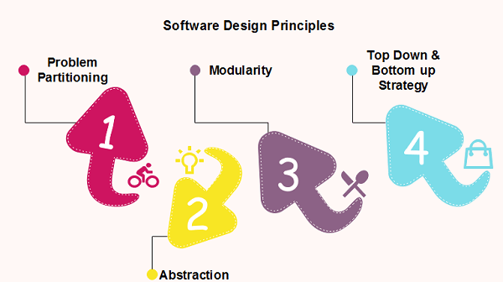
Design
Software design is the process of envisioning and defining software solutions to one or more sets of problems.
Architecture
Logical
Physical
Flowcharts
Sequence Diagrams / Text
UML
Activity/ Use case Diagrams (Behavioural)
Component / Class Diagrams (Structural)
Sequence/Collaboration Diagrams (Interaction)
Data Model / Entity Relationship (ER) Model
?
MVP Phase
High Level Design
Architecture
Sub systems and interactions
Low Level Design
Attributes
Data Structures
Methods
Alogorithms

Slide 9
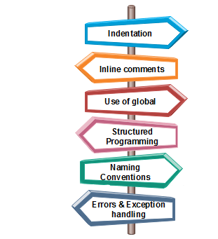
Implementation
Implementation / Coding Or Development is the process of transforming the design of the system into application code using high-level languages, software tools and libraries
This also involves unit testing of the code developed
Standards, Guidelines and Best Practices
Code Structuring and Program Design
Naming Conventions
Comments
Coding Practices – Use or Not Use of specific language features
Consistency and Uniformity
?
MVP Phase

Slide 10
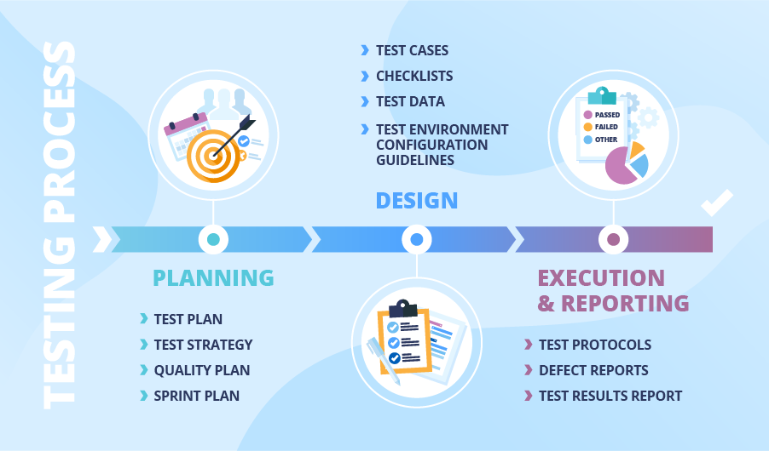
Testing
Software testing is a process to validate the functionality of a software application with an intent to find whether the developed software met the specified requirements or not.
Manual Testing: ​is performed by person/people, by clicking through or interacting with the software and APIs with the appropriate tooling. Manual testing is very expensive as it requires someone to set up an environment and execute the tests themselves.
Automated Testing: ​is the process of testing the software using an automation tool to find the defects. In this process, testers execute the test scripts and generate the test results automatically by using automation tools.
Types of testing:
● Unit Testing
● Integration Testing
● System Testing
● User Acceptance Testing
● Smoke Testing
● Regression Testing
Testing Techniques:
Blackbox: ​is a type of testing where Tester have ​no information/knowledge about the internal structure of code or program.
Whitebox:​is a type of testing where Tester have information/knowledge about the internal structure of code or program. Generally developers perform this type of testing.
?
MVP Phase

Slide 11
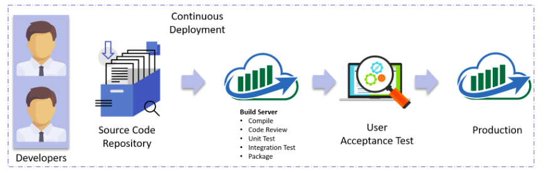
Deployment
Software deployment is all of the activities that make a software system available for use.
The general deployment process consists of several interrelated activities with possible transitions
These activities can occur at the producer side or at the consumer side or both.
Automation of these processes is called devOps
?
MVP Phase
Continuous Integration is integrating code into a shared repository frequently that can be verified by an automated build and automated tests
Continuous Deployment is the process by which qualified changes are deployed to production as soon as they are ready and without human intervention
Continuous Delivery is the practice in which teams develop, build, test, and release software in short cycles.

Slide 12
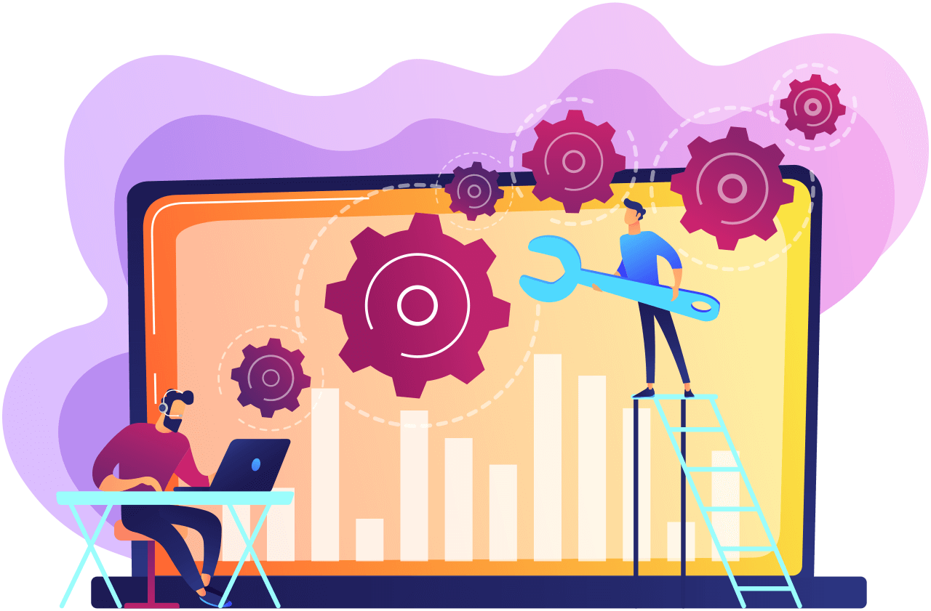
Maintenance and Support
?
Maintenance is modification of a software product after delivery to correct faults, to improve performance or other attributes.
Bug Fixes
Enhancements
Technology Refreshes (TR) or Upgrades
Software support is technical support or break/fix services that are delivered for specific software products
Remote troubleshooting capabilities
installation assistance and
basic usability assistance.
Supported by multiple levels of support teams
Level1 – On call Support
Level2 – Break/Fixes
Level3 – Bug Fixes / Enhancements
MVP Phase

Slide 13

THANK
YOU
INFINITE COMPUTER SOLUTIONS

